Slide 1
Decorator and Strategy Patterns
CS350/SE310
Fall, 2015

Slide 2
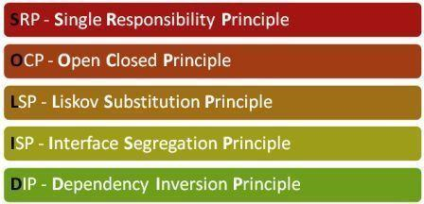
SOLID

Slide 3
An exercise in OO problem solving

Slide 4
The Coffee Joint project
You have been hired to help with an ordering and accounting system for a the fastest growing coffee shops chain, StarBuzz
Their locations and their beverage offerings are growing more quickly that you can say “A tall latte”!
So quickly they have problems keeping their ordering systems up-to-date

Slide 5
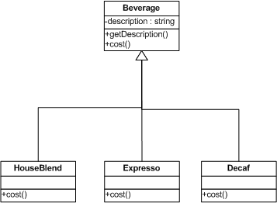
Original design
Beverage is an abstract
super-class for all types of beverages offered
cost() must be implemented by each Beverage sub-class

Slide 6
A Change
StarBuzz will offer different types of coffee-based beverage
Mocha
Latte
Cappuccino
…

Slide 7
Solution 1:
Each cost() implementation must account for all ingredients of that Beverage

Slide 8
Comments on Solution 1:

Slide 9
What if?
What if a new optional caramel topping is introduced?
What if the milk price goes up?
What if a new basic type of beverage, say tea, is launched?
What if you want double mocha?

Slide 10
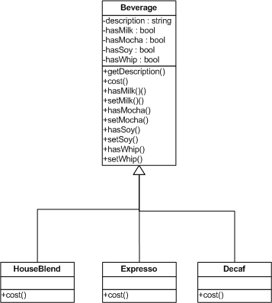
Solution #2

Slide 11
Solution #2 - cont.
Beverage is no more abstract
Implements the cost() method
Using info in its instance variables
For each actual beverage:
The cost() method calls super.cost()
Then adds its own pricing to that result

Slide 12
Solution # 2 - comments
Every time a new condiment or other ingredient is included in the offering we have some code change.
What is the impact?
on the structure of the Beverage class
on the algorithm of Beverage.cost ()
These recurring changes to existing code increase the chances of introducing bugs or bad side effects

Slide 13
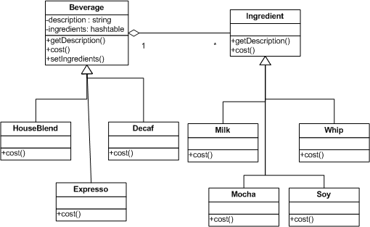
Solution #3

Slide 14
Solution #3 - cont.
Again, Beverage is not abstract anymore and implements cost()
It contains a data structure to assign a variety of different ingredients as components of Beverage
Beverage.cost() traverses the data structure and invokes all cost() method of the various ingredients
Another hierarchy for ingredients is rooted in an Ingredient abstract class
Also has a cost() method

Slide 15
Solution #3 - cont.
In the implementation of cost(), it implies that the ingredient cost is added before or after the cost of the coffee
In many cases, the order of these behaviors can not be determined beforehand.
Input/Output Stream
Text/Graph Border and Scroller

Slide 16
Java stream classes

Slide 17
Meet the Decorator pattern …

Slide 18
The basic idea
Start with an instance (object) of some type of beverage
“Decorate” that instance at run time with other objects for ingredients
Think of decorator objects as wrappers
Every instance of beverage served is a different collection of objects
Many decorators + 1 main beverage instance
Example order:
HouseBlend with double mocha and whipped cream

Slide 19
Constructing your order
:Whip
:Mocha1
:Mocha2
:HouseBlend
cost()
cost()
cost()
cost()

Slide 20
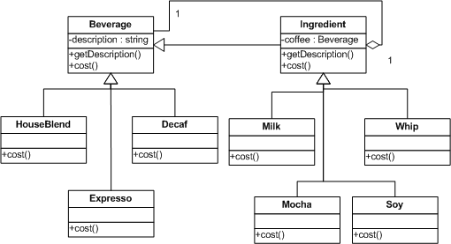
Class diagram

Slide 21
Decorator - comments
All types of decorators have the same super-type as the object they decorate
You can pass around the wrapping decorator object
instead of the “decorated” object
Behavior: The decorator executes its own behavior either before or after invoking the same behavior on the object it wraps
Depending on business logic
Dynamism: decorator objects can be added at run time at any moment

Slide 22
Decorator: a definition
“The Decorator pattern dynamically attaches additional responsibilities to an object”
Decorators provides an alternative to inheritance for extending functionality
Through wrapping, i.e. composition
Remember: Favor composition over inheritance

Slide 23
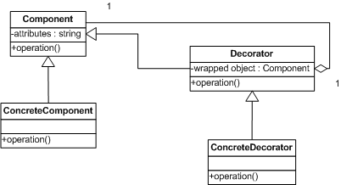
Decorator structure

Slide 24
The Decorator pattern
Classification:
Structural purpose; object scope
Context: dynamically add functionality
Problem: you want to use the basic functionality of an object, but you may need to invoke either before or after that some extra functionality
Solution: extension of basic functionality without subclassing
Consequences:
Small objects that host extra functionality only
Instantiates possibly a lot of objects

Slide 25
Real-world Decorators

Slide 26
Decorator usage: Java I/O
The Java I/O library of “stream” classes is an example of the Decorator pattern
java.io.InputStream is the abstract Component
Specialized by a bunch of concrete types of input stream classes
java.io.FilterInputStream is the abstract Decorator

Slide 27
Java stream classes
Adds buffering
behavior
Concrete components
Decorators
Adds encryption
behavior
Decorator
base class

Slide 28

Bullet Points
Inheritance is one form of extension, but not necessarily the best way to achieve flexibility in our designs.
In our designs we should allow behavior to be extended without the need to modify existing code.
Composition and delegation can often be used to add new behaviors at runtime.

Slide 29
Bullet Points
The Decorator Pattern provides an alternative to subclassing for extending behavior.
The Decorator Pattern involves a set of decorator classes that are used to wrap concrete components.
Decorator classes mirror the type of the components they decorate. (In fact, they are the same type as the components they decorate, either through inheritance or interface implementation.)

Slide 30
Bullet Points
Decorators change the behavior of their components by adding new functionality before and/or after (or even in place of) method calls to the component.
You can wrap a component with any number of decorators.
Decorators are typically transparent to the client of the component
unless the client is relying on the component’s concrete type.

Slide 31
More problems …
The company introduces sizes for their beverages:
size attribute: {small, medium, large}
getSize(), setSize() methods added to Beverage
Pricing depends on size, for the beverage as well as for ingredients
How would you modify the Decorator classes to handle pricing with size?

Slide 32
Another Change: Starbuzz now offers tea
Can you add Tea to existing beverage list?
Different kinds of tea have different prices:
Chrisansemum tea, Jasmine tea, ginseng tea…
More requirements:
Tea and Coffee should be prepared differently
Actually,
Different kinds coffee are prepared differently
Different kinds of teas are prepared differently
Question to think:
Can you use factory patterns? Why or why not?
What’s the fundamental differences between the Coffee/Tea problem and the MazeGame problem?

Slide 33
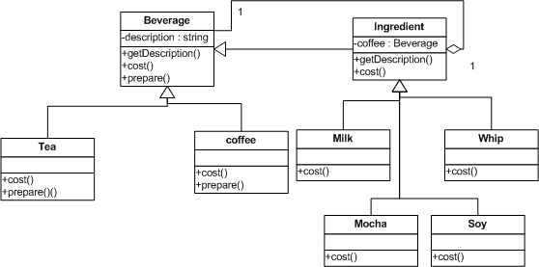
Solution 1: Using Override to Prepare Different Beverage

Slide 34
Problem statement
Be aware of the extensibility requirements (design for the unknown)
Use OO to obtain substantial re-use
Maximize maintainability
Goal:
highly maintainable + highly re-usable code

Slide 35
What we have here
A localized update to the code caused a non-local side effect.
A great use of inheritance for the purpose of reuse hasn’t turned out so well when it comes to maintenance
Goal:
☑highly reusable + highly maintainable

Slide 36
Your solution?

Slide 37
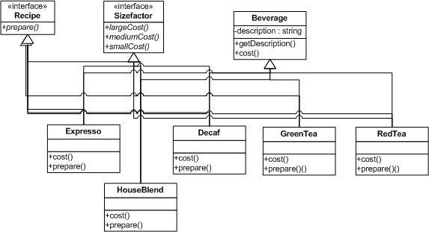
How about using interfaces?
HouseBlend and Decaf share the same recipe
Green Tea and Red Tea share the same recipe
Green Tea and Decaf share the same size facto

Slide 38
What we have here
Completely destroys code reuse
Creates a different maintenance nightmare.
There might be more than one kind of size factor even among different kinds of tea or coffee
Goal:
higly reusable + highly maintainable

Slide 39
Design Principle
Information Hiding: Identify the aspects of your application that vary and separate them from what stays the same.
Take what varies and “extract” it so it won’t affect the rest of your code
The result? Fewer unintended consequences from code changes and more flexibility in your system

Slide 40
Separating what changes from what stays the same
What is changing in the CoffeJoint objects?
Size factor and recipe preparation
To separate these behaviors from the Beverage class, we will:
pull both methods out of the Beverage class
create a new set of classes to represent each behavior

Slide 41
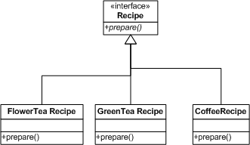
Separate Recipe Behavior

Slide 42
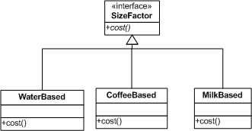
Separate Size Factor

Slide 43
Integrating the Beverage Behavior
New Beverage

Slide 44
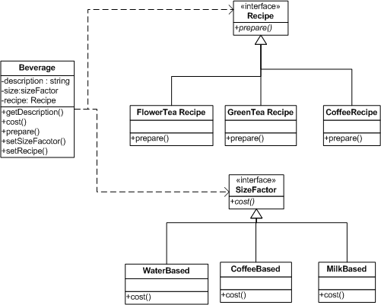
The big picture

Slide 45
Strategy Pattern - structure

Slide 46
What we have here
Reuse:
Still take advantage of super-class Beverage as a framework
Extendibility:
Maintainability:
Changes and extensions are localized and do not have ripple effects
Goal:
☑higly reusable + ☑highly maintainable

Slide 47
Official Strategy Pattern

Slide 48
The Strategy pattern
Classification:
Behavioral purpose; Class scope
Pattern context: when you need to use different business rules or algorithms depending on the context of the processing
Problem: algorithm to be applied needs to be selected based on the data type (or the client making the request)
Consequences:
Defines a family of algorithms
Gets rid of switches or other condition controls
MUST invoke all algorithms through the same interface

Slide 49
Design Principle
Dependency Inversion: Program to an interface, not an implementation.
Favor composition over inheritance
Lesson: knowing major OO concepts like encapsulation inheritance, polymorphism does not automatically make a good designer
A design guru thinks about how to create flexible designs that are maintainable and that can cope with change.

Slide 50
Dealing with change
What is going to change?
How to deal with it?
That is why we learn design patterns
All patterns provide a way to let some part of a system vary independently of all other parts

Slide 51
Design Principle
Information Hiding: Identify the aspects of your application that vary and separate them from what stays the same.
Take what varies and “extract” it so it won’t affect the rest of your code
The result? Fewer unintended consequences from code changes and more flexibility in your system

Slide 52
Composition vs. inheritance
They both are ways to re-use functionality
Inheritance:
Re-use functionality of parent class
Statically decided (inheritance decided at run time)
Weakens encapsulation
Composition:
Re-use functionality of objects collected at run-time
Invoked through the interface
More dynamic: multiple types with same interface
Black-box re-use

Slide 53
Composition vs. inheritance (2)
Composition allows more behavior flexibility
When possible use it instead of inheritance
Inheritance is still a quick way to design new components that are variants of exhisting ones
Over-use of inheritance creates bloated hierarchies
Code is more difficult to maintain
Unnecessary baggage for many classes
Composition drawback: it becomes harder to understand the behavior of a program by looking only at its source code
Semantics of interaction are decided at run-time

